Slide 1
Object-Oriented Development (CIS1056-N)
Module Introduction

Slide 2

Teaching team
Module Leader James Fairbairn
Email j.fairbairn@tees.ac.uk
Module Tutor Steven Mead
Email steven.j.mead@tees.ac.uk
Module Tutor Chris Curry
Email c.curry@tees.ac.uk
See Blackboard for online materials: https://eat.tees.ac.uk

Slide 3

Today’s agenda
Get familiar with the module aims and learning outcomes.
Familiarise ourselves with how this module will be delivered.
Take a look at how the module will be assessed.

Slide 4
Module introduction
Aims, outcomes, indicative content and proposed schedule.

Slide 5

Module aims
Knowledge of fundamental object-oriented concepts including classes, objects, methods, and encapsulation.
Familiarity with the basic tools required for software development i.e. a source code editor and a command line interface.
The practical skills required to implement simple applications using the an appropriate programming language.
Experience with other aspects of the software development process (i.e. designing solutions, testing application code, documenting the finished product).

Slide 6
Learning outcomes (part 1.)
Personal and Transferable Skills
Produce software documentation using source code comments.
Prepare reflective report to consider the effectiveness of the solution, workload, planning and development activities.
Research, Knowledge and Cognitive Skills
Demonstrate knowledge of basic OO concepts including classes, objects, methods, and encapsulation.
Build an effective solution to a simple requirement specification using appropriate development methods. .
Test a software application using a set of documented test cases.

Slide 7

Learning outcomes (part 2.)
Professional Skills
Implement a simple application using an appropriate programming language.
Describe the legal and security issues related to software development.
Discuss own performance whilst constructing a software solution.

Slide 8

Indicative content
This module will examine the following topics:
Basic Java syntax (class declarations, reserved words, variables, identifiers etc.).
Software development tools (IDEs such as NetBeans).
Input and output (including file handling).
Software documentation using source code comments.
Software testing using formal test cases.
Java’s implementation of object-orientation.

Slide 9

Assessment
This assessment will require students to design, implement, and test an application that processes simple data and displays the results.
Students will be assessed for:
appropriate data input/validation,
use of basic object orientated techniques (classes, objects, methods, and encapsulation);
adherence to coding house style;
their performance and workload management; overall completeness/effectiveness of the solution,
Testing (test cases) and evaluation with secuty and legal considerations (700-word reflective report).

Slide 10
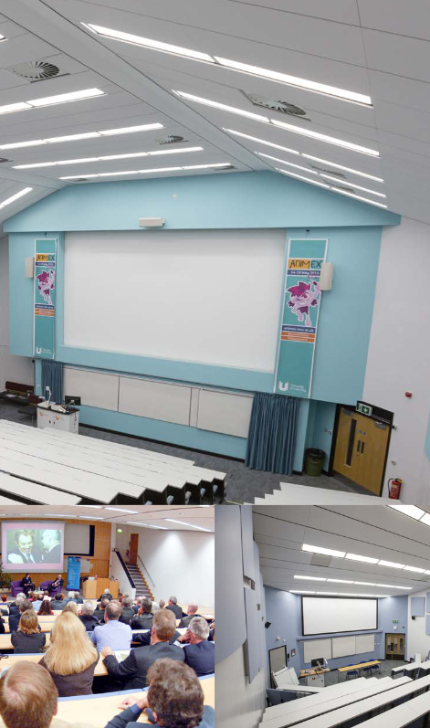
Scheduled time (part 1.)
Lecture: 2 x 1 hour(s) per week
Focussed lecture and discussion sessions will be used to explore and discuss the subject area, some based around programming language theory, to extend your knowledge of programming generally, and your knowledge of Java specifically.
Active involvement is essential for learning and thus you should bring pen and paper (or digital note taking device) to every lecture and be prepared to discuss topics with others.

Slide 11

Scheduled time (part 2.)
Tutorial: 2 hour(s) per week
Face to face IT laboratory sessions will develop your understanding of these concepts through problem-based learning. You will be expected to complete several guided programming challenges each week to further your understanding.
You should not expect to complete all exercises in the allotted time and will need to complete these outsides of class ready for the next week (see below). If at any point you are unsure of what to do immediately request help from your tutor, we are here to help.

Slide 12

Self directed study time
Not all your learning hours for this module will appear on your timetable.
For every hour spent in class, you are expected to work for 2 hours outside of class.
This means you should budget for ~8 hours of “self-directed study time” (SDST) per week.
Why not block out two free mornings/afternoons each week?
Study Time should be used for:
Practicing your programming skills / worksheets.
Reading books about Java.
Completing practical exercises.

Slide 13
Schedule
Week | Lecture 1 | Lecture 2 | IT Lab & Weekly Feedback on Progress
1 | Hello World! | Primitive types and operators | Hello World! Variables, types and operators
2 | Conditionals and the ‘if’ statement | Tax code live demonstration | Selection
3 | Strings | Iteration using ‘while’ | Strings and ‘while’ loops
4 | Iteration using ‘do-while’ and ‘for’ | Java Array | ‘for’ loops and arrays
5 | ‘switch’ statement | Exceptions and text file handling | Exceptions and text file handling
6 | ‘static’ methods and JavaDoc | Introduction to Object-Orientation (OO) | ‘static’ methods
7 | ICA Briefing | Legal and security issues | Encapsulation, constructors, setters, and getters | OO programming exercises
8 | UML Class Diagrams | Test cases and OO live demonstration | Documenting and testing code
9 | Java ArrayList | Implementing a Library with Books (demo) | Java collections and consolidation
10 | Formatting and enumeration | 2D Arrays and “collections within collections” | Playing cards and further OO exercises
11 | Inheritance | Inheritance live demonstration | Metalli business case study
12 | ‘static’ keyword in depth | ICA Support | ICA Support & Formative Feedback
 | Winter Break (Reserve first week for ICA/Personal Catch-up time)
13 | ICA Support/ICA Hand-in
Note: The schedule may be adjusted based on class progress.

Slide 14
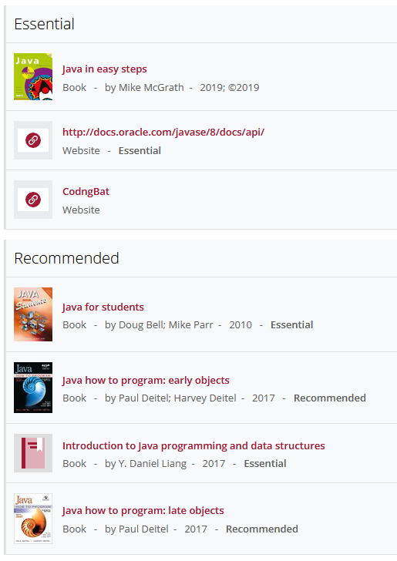
See Reading Lists Online
A comprehensive resource list is available on Blackboard. See Java Programming -> Library Resources -> Module Reading List.
Many of these resources are available to view online.
Check https://www.tees.ac.uk/depts/lis/ for textbook availability. Often both short-term and long-term loans are available.
This is a small guided selection; you are responsible for finding additional resources.

Slide 15
Getting support
What to do when you need help.

Slide 16

Getting support (part 1.)
We are on Microsoft Teams
The team will be available throughout the module, every week via Microsoft Teams for the duration of our timetabled sessions together.
Contact us there between these times to access fast support. You’ll be able to share your screen with us etc. so we can get to the bottom of any difficulties you experience.

Slide 17

Getting support (part 2.)
We are available on email
When we are not available on Teams, you get in touch via email at:
j.fairbairn@tees.ac.uk
steven.j.mead@tees.ac.uk
c.curry@tees.ac.uk
We aim to get back to you as soon as we possibly can.
You can also send us your code via email to get feedback on it!

Slide 18
Any questions?
Module Leader James Fairbairn
Email j.fairbairn@tees.ac.uk
Module Tutor Steven Mead
Email steven.j.mead@tees.ac.uk
Module Tutor Chris Curry
Email c.curry@tees.ac.uk
See Blackboard for online materials: https://eat.tees.ac.uk

